Slide 1
COVID-19 for Community Members
March 2020

Slide 2
COVID-19 Current Situation
On December 31, 2019, an outbreak of pneumonia associated with a new coronavirus (COVID-19) was reported in China.
The outbreak is thought to have begun at a market for live poultry, wild animals and seafood in Wuhan, China.
China has shut down the Wuhan market, as well as domestic and international transportation links from Wuhan and other affected cities in an attempt to contain the spread of the virus.
Since then, COVID-19 has spread to many other countries.

Slide 3
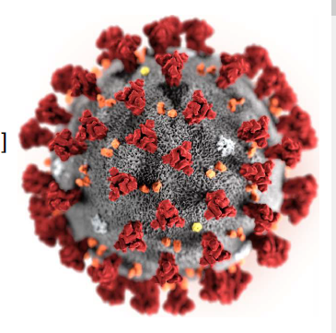
What is Coronavirus?
Coronaviruses are a large family of viruses which may cause illness in animals or humans.
In humans, several coronaviruses are known to cause respiratory infections ranging from the common cold to more severe diseases such as Middle East Respiratory Syndrome (MERS) and Severe Acute Respiratory Syndrome (SARS).
The most recently discovered coronavirus causes coronavirus disease COVID-19.
Source: WHO (February 2020) Infection Prevention and Control for Novel Coronavirus (COVID-19)
Reference: World Health Organization (February 23, 2020). Q&A on coronaviruses (COVID-19). Retrieved from https://www.who.int/news-room/q-a-detail/q-a-coronaviruses

Slide 4
Is COVID-19 the same as SARS?
No.
The virus that causes COVID-19 and the one that causes Severe Acute Respiratory Syndrome (SARS) are related to each other genetically, but they are different.
SARS is more deadly but much less infectious than COVID-19.
There have been no outbreaks of SARS anywhere in the world since 2003.
Reference: World Health Organization (February 23, 2020). Q&A on coronaviruses (COVID-19). Retrieved from https://www.who.int/news-room/q-a-detail/q-a-coronaviruses

Slide 5
Did the name change?
Yes.
It was initially called novel Coronavirus nCoV-19
The World Health Organization changed the name:
CO -“corona”, VI-“virus”, D-“disease” and the year it emerged 2019 = COVID-19
COVID-19 the official name for this disease
Source: Centers for Disease Control (February 2020) Frequently Asked Questions and Answers; AHS (February 2020) Novel Corona virusn FAQ’s for the Public.

Slide 6
The numbers as of March 8, 2020 (WHO Situation Report – 48)
Globally – over 100 countries have reported cases of COVID-19
105,586 cases reported
China – 80,859
Outside of China – 24,727
3,584 deaths
China – 3,100
Outside of China – 484
The WHO updates these numbers daily in the Situation Reports which can be found at the link below.
In recent days, cases have been increasing by over 2,000/day and deaths have been increasing by about 60/day.
The number of new cases in China is starting to slow down and the number of new cases in other parts of the world are starting to increase.
WHO (2020). Coronavirus disease (COVID-19) outbreak
https://www.who.int/emergencies/diseases/novel-coronavirus-2019

Slide 7
The numbers in Canada as of March 8, 2020
To date, 62 cases have been announced in Canada.
There are 7 presumptive cases in Alberta.
Alberta Health (2020). COVID-19 coronavirus info for Albertans.

Slide 8
How does COVID-19 spread?
People can catch COVID-19 from others who have the virus.
The disease can spread from person to person through small droplets from the nose or mouth which are spread when a person with COVID-19 coughs or sneezes.
These droplets also land on objects and surfaces around the person. Other people then catch COVID-19 by touching these objects or surfaces, then touching their eyes, nose or mouth.
People can also catch COVID-19 if they breathe in droplets from a person with COVID-19 who coughs or sneezes.
This is why it is important to stay more than 2 meters (6 feet) away from a person who is sick.
Reference: World Health Organization (February 23, 2020). Q&A on coronaviruses (COVID-19). Retrieved from https://www.who.int/news-room/q-a-detail/q-a-coronaviruses

Slide 9
What are the symptoms of COVID-19?
The most common symptoms of COVID-19 are fever, tiredness, and dry cough.
Some patients may have aches and pains, nasal congestion, runny nose, sore throat or diarrhea.
These symptoms are usually mild and begin gradually.
Some people become infected but don’t develop any symptoms and don't feel unwell.
Reference: World Health Organization (February 23, 2020). Q&A on coronaviruses (COVID-19). Retrieved from https://www.who.int/news-room/q-a-detail/q-a-coronaviruses

Slide 10
Who is most likely to get sick?
Anyone can get the disease, the risk depends on where you live or where you have travelled recently.
The risk of infection is higher in areas where a number people have been diagnosed with COVID-19.
For people in other parts of the world, your risk of getting COVID-19 is currently variable. It is important to be aware of the situation and preparedness efforts in your area.
We are still learning about how COVID-2019 affects people, however, some groups appear to develop serious illness more often than others:
older persons
persons with pre-existing medical conditions
high blood pressure
heart disease
lung disease
Cancer
diabetes
Reference: World Health Organization (February 23, 2020). Q&A on coronaviruses (COVID-19). Retrieved from https://www.who.int/news-room/q-a-detail/q-a-coronaviruses

Slide 11
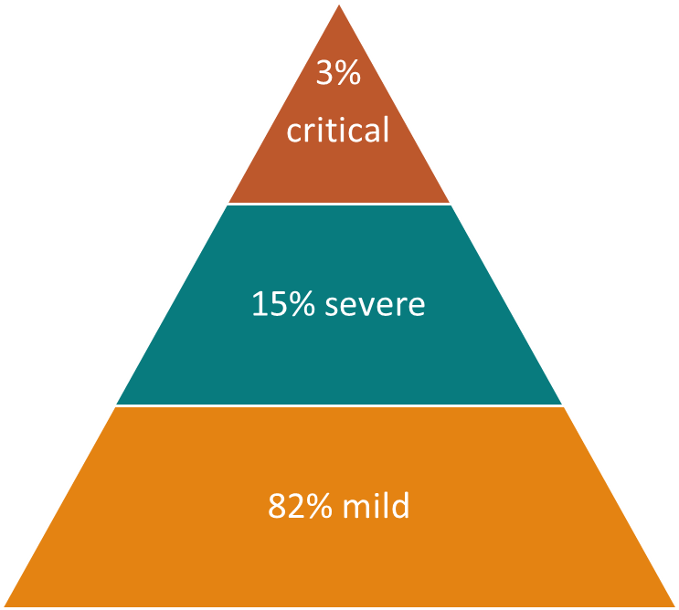
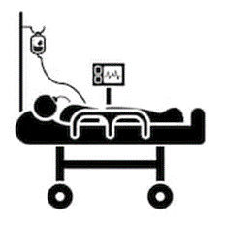
COVID-19 estimates on clinical severity (n=17185)
Source: World Health Organization (February 20 2020). EPI WIN Power point.

Slide 12
Should I worry about COVID-19?
Illness due to COVID-19 infection is generally mild, especially for children and young adults.
However, it can cause serious illness: about 1 in every 5 people who catch it need hospital care. It is therefore quite normal for people to worry about how the COVID-19 outbreak will affect them and their loved ones.
We can channel our concerns into actions to protect ourselves, our loved ones and our communities.
First and foremost among these actions is regular and thorough hand-washing and good respiratory hygiene.
Secondly, keep informed and follow the advice of the local health authorities including any restrictions put in place on travel, movement and gatherings.
Reference: World Health Organization (February 23, 2020). Q&A on coronaviruses (COVID-19). Retrieved from https://www.who.int/news-room/q-a-detail/q-a-coronaviruses

Slide 13
Should I worry about COVID-19? (con’t)
Most people (about 80%) recover from the disease without needing treatment.
Around 1 out of every 6 people who gets COVID-19 becomes seriously ill and develops difficulty breathing.
Older people, and those with underlying medical problems like high blood pressure, heart problems or diabetes, are more likely to develop serious illness.
Reference: World Health Organization (February 23, 2020). Q&A on coronaviruses (COVID-19). Retrieved from https://www.who.int/news-room/q-a-detail/q-a-coronaviruses

Slide 14
How likely am I to catch COVID-19?
The risk depends on where you are - and more specifically, whether there is a COVID-19 outbreak unfolding there.
For most people in most locations the risk of catching COVID-19 is still low. However, there are now places around the world (cities or areas) where the disease is spreading. For people living in, or visiting these areas, the risk of catching COVID-19 is higher.
Currently, the risk to Albertans is low.
AHS/AH and FNIHB are carefully monitoring and taking the necessary steps to find cases and prevent the ongoing spread of the virus.
References: World Health Organization (February 23, 2020). Q&A on coronaviruses (COVID-19). Retrieved from https://www.who.int/news-room/q-a-detail/q-a-coronaviruses; Alberta health Services (February 2020). Novel coronarvirus (COVID-19) FAQs for Public).

Slide 15
Can COVID-19 be caught from a person who has no symptoms?
The main way the disease spreads is through respiratory droplets expelled by someone who is coughing.
The risk of catching COVID-19 from someone with no symptoms at all is very low.
However, many people with COVID-19 experience only mild symptoms. This is particularly true at the early stages of the disease.
It is therefore possible to catch COVID-19 from someone who has, for example, just a mild cough and does not feel ill.
Reference: World Health Organization (February 23, 2020). Q&A on coronaviruses (COVID-19). Retrieved from https://www.who.int/news-room/q-a-detail/q-a-coronaviruses

Slide 16
Can I catch COVID-19 from the feces of someone with the disease?
The risk of catching COVID-19 from the feces of an infected person appears to be low.
While initial investigations suggest the virus may be present in feces in some cases, spread through this route is not a main feature of the outbreak.
Because this is a risk, however, it is another reason to clean hands regularly, after using the bathroom and before eating.
The World Health Organization is assessing ongoing research on the ways COVID-19 is spread and will continue to share new findings.
Reference: World Health Organization (February 23, 2020). Q&A on coronaviruses (COVID-19). Retrieved from https://www.who.int/news-room/q-a-detail/q-a-coronaviruses

Slide 17
Can humans become infected with COVID-19 from an animal source?
Coronaviruses are a large family of viruses that are common in animals.
To protect yourself when visiting live animal markets:
Avoid direct contact with animals and surfaces in contact with animals.
Ensure good food safety practices at all times.
Handle raw meat, milk or animal organs with care to avoid contamination of uncooked foods and avoid consuming raw or undercooked animal products.
There is no evidence that companion animals or pets (such as cats and dogs) have been infected or could spread the virus that causes COVID-19.
Reference: World Health Organization (February 23, 2020). Q&A on coronaviruses (COVID-19). Retrieved from https://www.who.int/news-room/q-a-detail/q-a-coronaviruses

Slide 18
I was on a flight with someone who looked sick. Am I at risk?
Influenza and the common cold are far more likely causes of respiratory illness among travelers.
You can protect yourself by washing your hands often and well, and getting your annual influenza vaccine.
Returning travelers on international flights may be screened at the airport.
If any cases are diagnosed among travelers to Alberta, Public Health will be following up with anyone who was exposed.

Slide 19
How long will it take to develop symptoms after being exposed to COVID-19?
The “incubation period” means the time between catching the virus and beginning to have symptoms of the disease.
Most estimates of the incubation period for COVID-19 range from 1-14 days, most commonly around 5 days.
These estimates will be updated as more data become available.
Reference: World Health Organization (February 23, 2020). Q&A on coronaviruses (COVID-19). Retrieved from https://www.who.int/news-room/q-a-detail/q-a-coronaviruses

Slide 20
Who should be evaluated for COVID-19?
People with fever and/or a cough or shortness of breath and in the last 14 days before illness onset meet any of the following criteria:
• Travelled to affected areas;
OR
• Had close contact with a confirmed or probable case of COVID-19;
OR
• Had close contact with a person with acute respiratory illness who had been to affected areas;
OR
• Had laboratory exposure to biological material (e.g. primary clinical specimens, virus culture isolates) known to contain COVID-19 virus.
Anyone meeting these criteria should avoid contact with others and call Health Link (811) for advice.
Alberta Health (2020). Alberta public health disease management guidelines: Coronavirus – COVID-19.

Slide 21
What should I do if I think I have COVID-19?
If you are sick and meet the criteria on the previous slide:
• Stay home and call Health Link 811 for advice. You will be directed to a health care facility if it is necessary.
• If you are not seriously ill, do not go to a physician’s office, a health care facility or a lab without consulting with Health Link 811 first.
• If you are seriously ill and need immediate medical attention call 911 and inform them that you may have COVID-19
Alberta Health Services (March 3, 2020). Novel Coronavirus (COVID-19) FAQs for Public

Slide 22
What can I do to protect myself and prevent the spread of disease?
You can reduce your chances of being infected or spreading COVID-19 by taking some simple precautions:
Regularly and thoroughly wash your hands with soap and water or use an alcohol-based hand rub.
Why? Washing your hands with soap and water or using alcohol-based hand rub kills viruses that may be on your hands.
Maintain at least 2 metres (6 feet) distance between yourself and anyone who is coughing or sneezing.
Why? When someone coughs or sneezes they spray small droplets from their nose or mouth which may contain virus. If you are too close, you can breathe in the droplets, including the COVID-19 virus if the person coughing has the disease.
Reference: World Health Organization (February 23, 2020). Q&A on coronaviruses (COVID-19). Retrieved from https://www.who.int/news-room/q-a-detail/q-a-coronaviruses

Slide 23
What can I do to protect myself and prevent the spread of disease? (con’t)
Avoid touching your eyes, nose and mouth.
Why? Contaminated hands can transfer the virus to your eyes, nose or mouth. From there, the virus can enter your body and can make you sick.
Make sure you, and the people around you, follow good respiratory hygiene. This means covering your mouth and nose with your bent elbow or tissue when you cough or sneeze. Then dispose of the used tissue immediately.
Why? Droplets spread virus. By following good respiratory hygiene you protect the people around you from viruses such as cold, flu and COVID-19.
Clean and disinfect surfaces that are frequently touched.
Why? Hands touch many surfaces and can pick up viruses. Once contaminated, hands can transfer the virus to your eyes, nose or mouth.
Reference: World Health Organization (February 23, 2020). Q&A on coronaviruses (COVID-19). Retrieved from https://www.who.int/news-room/q-a-detail/q-a-coronaviruses

Slide 24
How long does the virus survive on surfaces?
It is not certain how long the virus that causes COVID-19 survives on surfaces, but it seems to behave like other coronaviruses.
Studies suggest that coronaviruses (including preliminary information on the COVID-19 virus) may persist on surfaces for a few hours or up to several days. This may vary under different conditions (e.g. type of surface, temperature or humidity of the environment).
Reference: World Health Organization (February 23, 2020). Q&A on coronaviruses (COVID-19). Retrieved from https://www.who.int/news-room/q-a-detail/q-a-coronaviruses

Slide 25
What should I use to clean and disinfect surfaces?
There is a lack of specific evidence for the effectiveness of specific cleaning products against COVID-19.
Cleaning with water and household detergents and the use of common disinfectant products should be sufficient for cleaning and disinfection.
If household or commercial disinfectant cleaning products are not readily available, hard surfaces can be disinfected using a mixture of 1 part bleach (5% sodium hypochlorite) and 9 parts water, ensuring the solution remains on the surface for 1 minute for disinfection.
After cleaning and disinfecting, wash your hands with soap and water. Avoid touching your eyes, mouth, or nose.

Slide 26
Should I wear a mask to protect myself?
If you are healthy, you only need to wear a mask if you are taking care of a person with a suspected COVID-19 infection.
Wear a mask if you are coughing or sneezing.
Masks are effective only when used in combination with frequent hand washing with soap and water or alcohol-based hand rub.
If you wear a mask, then you must know how to use it and dispose of it properly.
Disposable face masks can only be used once.
There is a shortage of masks, so the World Health Organization urges people to use masks wisely.
Reference: World Health Organization (February 23, 2020). Q&A on coronaviruses (COVID-19). Retrieved from https://www.who.int/news-room/q-a-detail/q-a-coronaviruses

Slide 27
Are antibiotics effective in preventing or treating COVID-19?
No.
Antibiotics do not work against viruses, they only work on bacterial infections.
COVID-19 is caused by a virus, so antibiotics do not work.
Antibiotics should not be used as a means of prevention or treatment of COVID-19. They should only be used as directed by a physician to treat a bacterial infection.
Reference: World Health Organization (February 23, 2020). Q&A on coronaviruses (COVID-19). Retrieved from https://www.who.int/news-room/q-a-detail/q-a-coronaviruses

Slide 28
Is there a vaccine, drug, or treatment for COVID-19?
To date, there is no vaccine and no specific antiviral medicine to prevent or treat COVID-2019.
However, those affected should receive care to relieve symptoms. People with serious illness should be hospitalized. Most patients recover thanks to supportive care.
Possible vaccines and some specific drug treatments are under investigation. They are being tested through clinical trials.
Reference: World Health Organization (February 23, 2020). Q&A on coronaviruses (COVID-19). Retrieved from https://www.who.int/news-room/q-a-detail/q-a-coronaviruses

Slide 29
If you have travelled outside Canada
If you have travelled outside Canada, it is important to monitor your health when you return.
If you may have come in contact with the novel coronavirus, monitor your health for :
Fever
Cough and
Difficulty breathing within 14 days after you arrive in Canada
If you have these symptoms, call HEALTH LINK 811.
If you have travelled to an affected area in the last 14 days, limit your contact with others for a total of 14 days from the date that you left the area. This means self-isolate and stay at home. In addition, contact HEALTH LINK within 24 hours of arriving in Canada.
Source: Government of Canada (February 2020). Coronavirus disease (COVID-19): Travel advice

Slide 30
I have been told to self-isolate, what does that mean?
Note: follow the instructions received from your health care professional
Self isolation means:
Avoiding social gatherings, work, school, child care, athletic events, university, faith-based gatherings, healthcare facilities, grocery stores, restaurants, shopping malls, and all public gatherings.
Avoid contact with people other than the family members/companions who you travelled with.
Avoid having visitors to your home.

Slide 31
Self-Isolation (con’t)
Self-isolation also means:
Avoid sharing household items such as dishes, drinking glasses, cups, eating utensils, towels, pillows, or other items with other people in your home.
Wash dishware thoroughly with soap and water or place in the dishwasher for cleaning. Wash clothing and linens in a washing machine.
Wear a surgical mask if you need to leave your home for an urgent errand (picking up essential medication)

Slide 32
When you are travelling (including local travel)
Wash your hands frequently with soap and water for at least 20 seconds.
Use alcohol-based hand sanitizer only if soap and water are not available. It is a good idea to always keep some with you when you travel.
Eat and drink safely. Stay away from raw or undercooked food and meat.
Avoid high-risk areas such as farms, live animal markets and areas where animals may be slaughtered.
Avoid close contact with people who may be sick, especially if they have difficulty breathing or have a fever or cough.
Avoid contact with animals (alive or dead), including pigs, chickens, ducks and wild birds, and items contaminated with their body fluids.
Source: Government of Canada (February 2020). Coronavirus disease (COVID-19): Travel advice

Slide 33
Can I still travel?
All travellers should be aware that there are health risks when you travel. It is important to check your destination before you leave to know the risks and to be prepared.
Visit the Government of Canada’s Travel Advice and Advisories website to review the most recent information for your destination: https://travel.gc.ca/travelling/advisories
Source: Government of Canada (February 2020). Coronavirus disease (COVID-19): Travel advice

Slide 34
Is it safe to receive a package from any area where COVID-19 has been reported?
Yes.
The likelihood of an infected person contaminating commercial goods is low and the risk of catching the virus that causes COVID-19 from a package that has been moved, travelled, and exposed to different conditions and temperature is also low.
Reference: World Health Organization (February 23, 2020). Q&A on coronaviruses (COVID-19). Retrieved from https://www.who.int/news-room/q-a-detail/q-a-coronaviruses

Slide 35
What is the Government of Canada doing?
Public Health Agency of Canada is monitoring the situation both on national and global fronts.
Border Health Services is screening at key airports that have direct flights from affected areas.
Guidance Documents have been developed.
Vaccine research and development is underway.
Notes:
Antivirals are also being investigated
New measures have been implemented at the 10 Canadian airports. Measures help to:
identify any travellers returning to Canada who may be ill
raise awareness among travellers about what they should do if they become sick
Any travellers coming to Canada who may have been in the province of Hubei would typically enter Canada through 1 of 3 international airports: Vancouver, Toronto, or Montréal.
Travellers going through these airports will see additional signage in French, English and Simplified Chinese, asking them to alert a border services officer should they have any flu-like symptoms.
Travellers will need to respond to a screening question that has been added to electronic kiosks for all international travellers at these airports. This question is available in 15 different languages.
Travellers who do not show signs or symptoms of illness will receive a handout advising them to follow up with their health care provider and provide:
their symptoms
their travel history
any high-risk exposure history (such as contact with animals or close contact with a sick person) if they develop symptoms
These measures complement routine traveller screening procedures already in place to prepare for, detect and respond to the spread of serious infectious diseases into and within Canada.
24. In which 10 airports have the additional screening measures been implemented?
Additional screening measures were put in place at the Vancouver, Toronto and Montréal international airports on January 22, 2020. As of February 1, 2020, the additional measures are also in place at the following airports:
Calgary International Airport
Edmonton International Airport
Winnipeg Richardson International Airport
Billy Bishop Toronto City Airport
Ottawa International Airport
Québec City Jean Lesage International Airport
Halifax Stanfield International Airport
New measures have been implemented at the 10 Canadian airports. Measures help to:
identify any travellers returning to Canada who may be ill
raise awareness among travellers about what they should do if they become sick
Any travellers coming to Canada who may have been in the province of Hubei would typically enter Canada through 1 of 3 international airports: Vancouver, Toronto, or Montréal.
Travellers going through these airports will see additional signage in French, English and Simplified Chinese, asking them to alert a border services officer should they have any flu-like symptoms.
Travellers will need to respond to a screening question that has been added to electronic kiosks for all international travellers at these airports. This question is available in 15 different languages.
Travellers who do not show signs or symptoms of illness will receive a handout advising them to follow up with their health care provider and provide:
their symptoms
their travel history
any high-risk exposure history (such as contact with animals or close contact with a sick person) if they develop symptoms
These measures complement routine traveller screening procedures already in place to prepare for, detect and respond to the spread of serious infectious diseases into and within Canada.
24. In which 10 airports have the additional screening measures been implemented?
Additional screening measures were put in place at the Vancouver, Toronto and Montréal international airports on January 22, 2020. As of February 1, 2020, the additional measures are also in place at the following airports:
Calgary International Airport
Edmonton International Airport
Winnipeg Richardson International Airport
Billy Bishop Toronto City Airport
Ottawa International Airport
Québec City Jean Lesage International Airport
Halifax Stanfield International Airport

Slide 36
What is FNIHB doing?
Indigenous Services Canada remains connected to the Public Health Agency of Canada and provincial health authorities on the domestic and international situation.
Personal protective equipment and infection control training has been conducted for health care providers in each region across the country.
Regions are reaching out to communities and providing further training and information on infection prevention and control.
Regions are working with respective communities to update their Health Emergency plans.

Slide 37
Be Prepared
Although China remains the epicentre of the COVID-19 outbreak, more countries are reporting cases. Some countries may not have the capacity to detect or contain the disease. This means global efforts to stop the spread of the disease may not be enough to prevent a pandemic.
The risk to Canadians is still low, it is important to be prepared at the individual and community level for all possible scenarios.
Canada's public health system is well equipped to contain cases coming from abroad.
In order to mitigate the impacts of COVID-19, everyone has a role to play.
Source: PHAC (March 2020) Coronavirus disease (COVID-19): Being Prepared

Slide 38
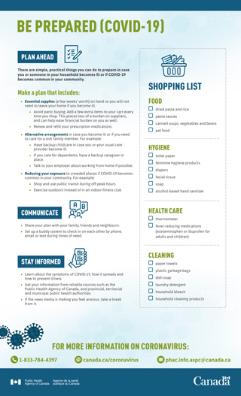
Canada's health system is ready to respond to cases that arise in Canada, but it is important that individuals and communities are ready if there is widespread illness here at home.
PHAC (March 7, 2020). Be prepared (COVID-19) factsheet.
https://www.canada.ca/en/public-health/services/diseases/2019-novel-coronavirus-infection/awareness-resources.html

Slide 39
Plan ahead
Take time to consider what you will do if you or a family member becomes sick and needs care.
Think about:
What food and household supplies you need for you and your family
What medicines you need, including renewing and refilling prescriptions ahead of time
Discuss your plans with your family, friends and neighbours, and set up a system to check in on each other by phone, email or text during times of need.

Slide 40
Plan ahead (con’t)
Fill your Prescriptions
See you health care provider ahead of time to ensure you have enough of your prescriptions as well as refills.
Have Essentials on hand
To ensure you do not need to leave your home while you are sick or busy caring for an ill family member.
Gradually purchase the items you need, for example:
dried pasta and sauce
prepared canned soups
canned vegetables and beans
pet food
regular detergents
household bleach
soap and alcohol-based hand sanitizer
toilet paper/paper towels
facial tissue
feminine hygiene products
diapers (if you have children who use them)
household cleaning products
garbage bags(for containing soiled tissues and waste
Notes:
To do this, you can add a few extra items to your grocery cart every time you shop.

Slide 41
Get prepared
Add a few extra items to your grocery cart every time you shop. This places less of a burden on suppliers, and can help ease financial burden on you as well.
Build on the kits you have prepared for OTHER potential emergencies. For more information on how to prepare yourself and your family in the event of an emergency, please visit https://www.canada.ca/en/public-health/services/publications/diseases-conditions/covid-19-be-prepared.html.

Slide 42
Stay healthy and limit the spread of illness
To protect against respiratory illness:
Wash your hands often and well.
Avoid touching your face, nose, or mouth.
Avoid close contact with people who are sick.
Consider a wave or elbow bump in place of a handshake, a hug or kiss.
Reduce your exposure to crowded places by shopping or using transit during non-peak hours.
Clean and disinfect surfaces that are frequently touched.
Stay at home and away from others if you are feeling ill. If you are not seriously ill, do not go to a physician’s office, a health care facility or a lab without consulting with Health Link 811 first.

Slide 43
Where can I find up-to-date information about COVID-19?
Information on COVID-19 changes quickly and is updated frequently. For the most up-to-date information, visit one of the following websites:
Alberta Health https://www.alberta.ca/coronavirus-info-for-albertans.aspx
Alberta Health Services https://www.albertahealthservices.ca/topics/Page16944.aspx
Pubic Health Agency of Canada
https://www.canada.ca/en/public-health/services/diseases/2019-novel-coronavirus-infection.html
World Health Organization https://www.who.int/emergencies/diseases/novel-coronavirus-2019
Follow Canada’s Chief Public Health Officer, Dr. Theresa Tam, on Twitter at @CPHO_Canada

Slide 44
QUESTIONS?

